Slide 1
INTRODUCTION TO
HEAD & NECK
Dr. ,
PROFESSOR, DEPT. OF ANATOMY.

Slide 2
SPECIFIC LEARNING OBJECTIVES:
At the end of the class the student must be able to understand the following
REGIONS OF HEAD
REGIONS OF NECK
IMPORTANT SURFACE LANDMARKS IN EACH REGION

Slide 3
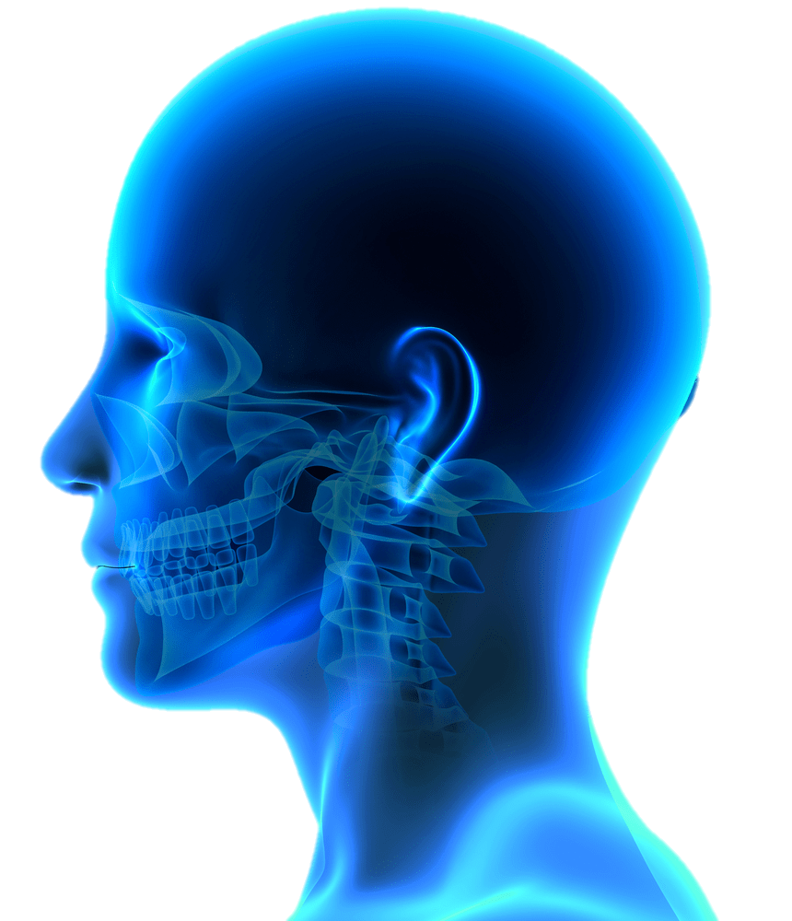
HEAD & NECK - PARTS
The head is the cranial end of the body.
Contains the brain, the special sense organs and the Openings of eyes, nose, and mouth.
The neck is a region that connects the head to the trunk and transmits the structures to and fro head and trunk.

Slide 4

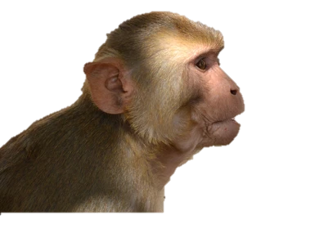

HEAD & NECK comparative anatomy
Pronograde – well-developed snout, and, their face is located in front of the cranium
Orthograde – projecting snout, and face is located below and in front of the cranium.
Plantigrade - face is located below the anterior part of the cranium.

Slide 5
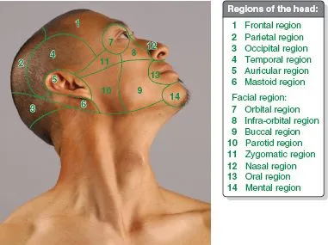
HEAD & NECK
REGIONS OF HEAD
Frontal REGION
Parietal REGION
Occipital REGION
Temporal REGION
Auricular REGION
MASTOID REGION
Orbital REGION
INFRAORBITAL RETION
Buccal REGION
Parotid REGION
zygomatic REGION
Nasal REGION
Oral REGION
Mental REGION

Slide 6

HEAD & NECK
Frontal REGION
SURFACE LANDMARKS
ANTERIOR HAIR LINE
The forehead
The superciliary arch
GLABELLA
frontal prominence

Slide 7
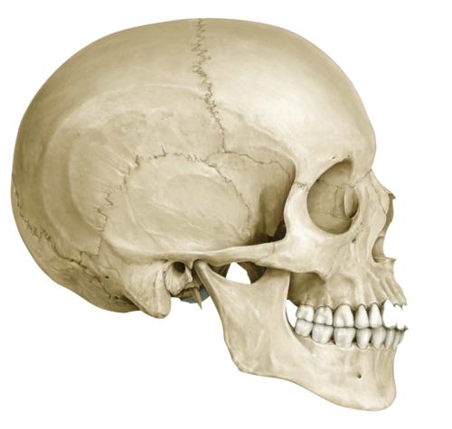
HEAD & NECK
Parietal REGION
SURFACE LANDMARKS
parietal eminence
temporal line
The EXTERNAL ACOUSTIC MEATUS

Slide 8
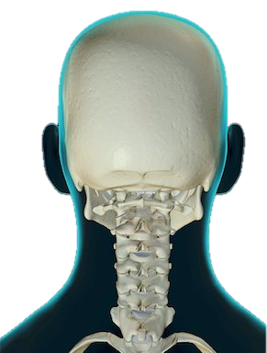
HEAD & NECK
OCCIPITAL REGION
SURFACE LANDMARKS
external occipital protuberance
superior nuchal line
THE MASTOID PROCESS

Slide 9
HEAD & NECK
TEMPORAL REGION
SURFACE LANDMARKS
TEMPORAL LINES
ZYGOMATIC ARCH
PTERION

Slide 10
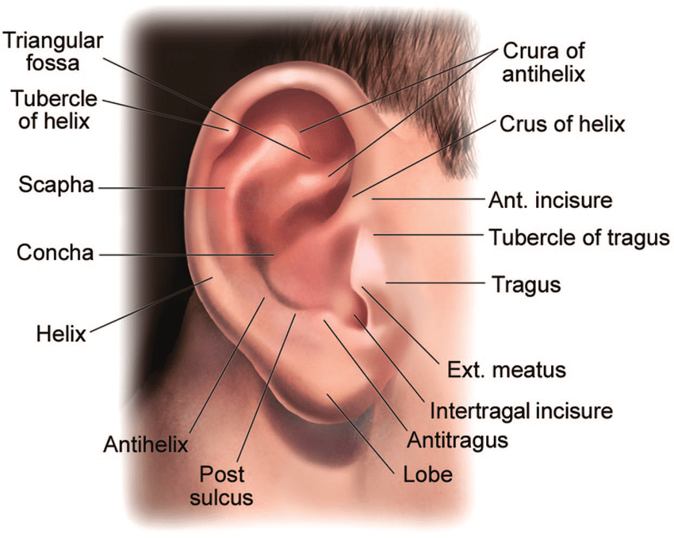
HEAD & NECK
AURICULAR REGION
SURFACE LANDMARKS
The EXTERNAL EAR AND EXTERNAL ACOUSTIC MEATUS

Slide 11
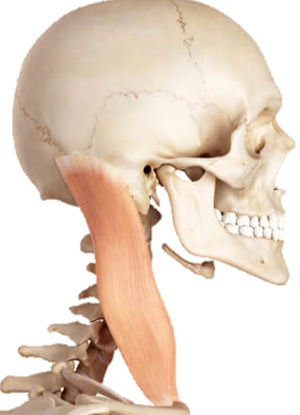
HEAD & NECK
MASTOID REGION
SURFACE LANDMARKS
MASTOID PROCESS
SUPRAMEATAL TRIAnGLE

Slide 12

HEAD & NECK
PAROTID REGION
SURFACE LANDMARKS
The EXTERNAL EAR AND EXTERNAL ACOUSTIC MEATUS
The MASTOID PROCESS
ANGLE OF THE MANDIBLE
The ZYGOMATIC ARCH

Slide 13

HEAD & NECK
ORBITAL REGION
SURFACE LANDMARKS
ORBIT
SUPERCILIARY ARCH
Conjunctiva
Cornea
lateral & MEDIAL canthus
lacrimal caruncle

Slide 14

HEAD & NECK
NASAL REGION
SURFACE LANDMARKS
external nose
ROOT OF NOSE
GLABELLA
ROOT AND BRIDGE OF NOSE
APEX OF NOSE
ALA
NOSTRILS

Slide 15
HEAD & NECK
INFRAORBITAL REGION
SURFACE LANDMARKS
infraorbital margin
infraorbital foramen - 1 cm below the infraorbital margin, infraorbital nerve block.

Slide 16
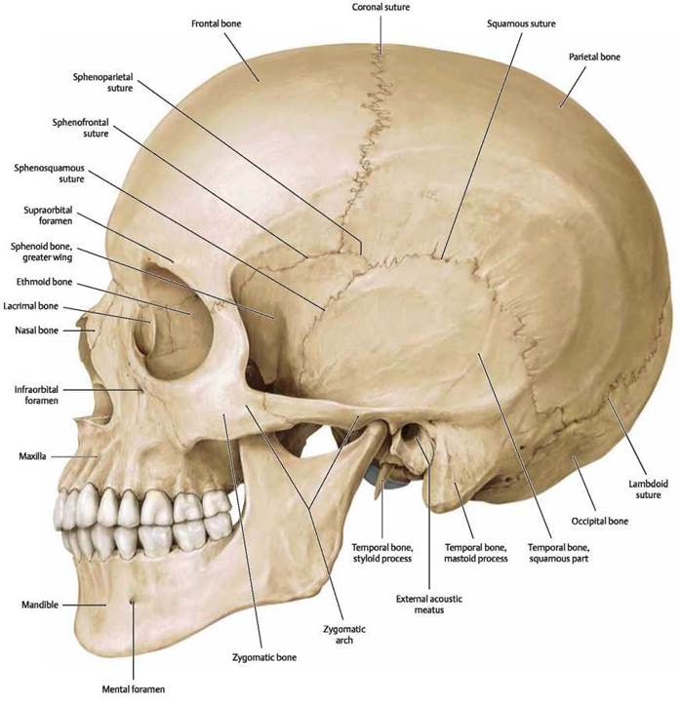
HEAD & NECK
ZYGOMATIC REGION
SURFACE LANDMARKS
zygomatic arch
temporomandibular joint

Slide 17
HEAD & NECK
ORAL REGION
SURFACE LANDMARKS
upper and lower lips
vermillion border
Philtrum
Tubercle of the upper lip
labial commissure
nasolabial sulcus
labiomental groove

Slide 18
HEAD & NECK
MENTAL REGION
SURFACE LANDMARKS
mental protuberance or mentum

Slide 19
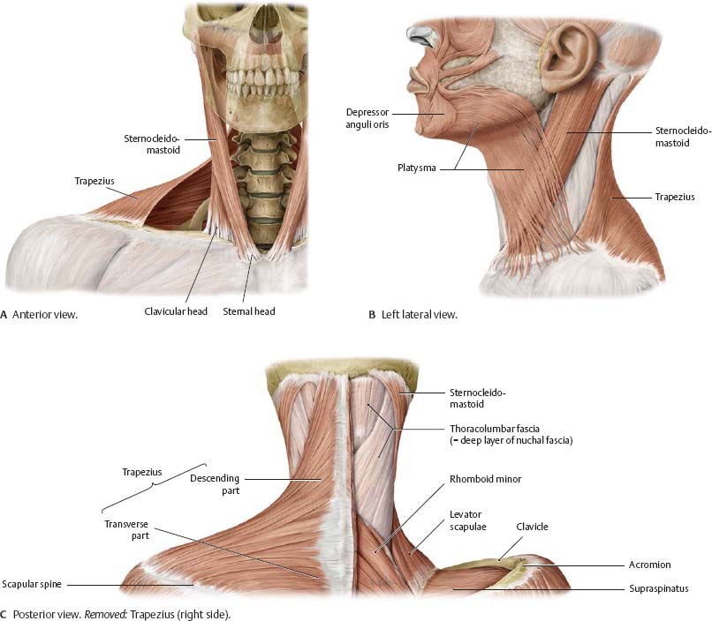
HEAD & NECK
REGIONS OF NECK
Anterior region.
2. Right lateral region.
3. Left lateral region.
4. Posterior region (nucha).

Slide 20

HEAD & NECK
ANTERIOR REGION
SURFACE LANDMARKS
laryngeal prominence
Suprasternal (jugular) notch
Cricoid cartilage
Tracheal rings

Slide 21
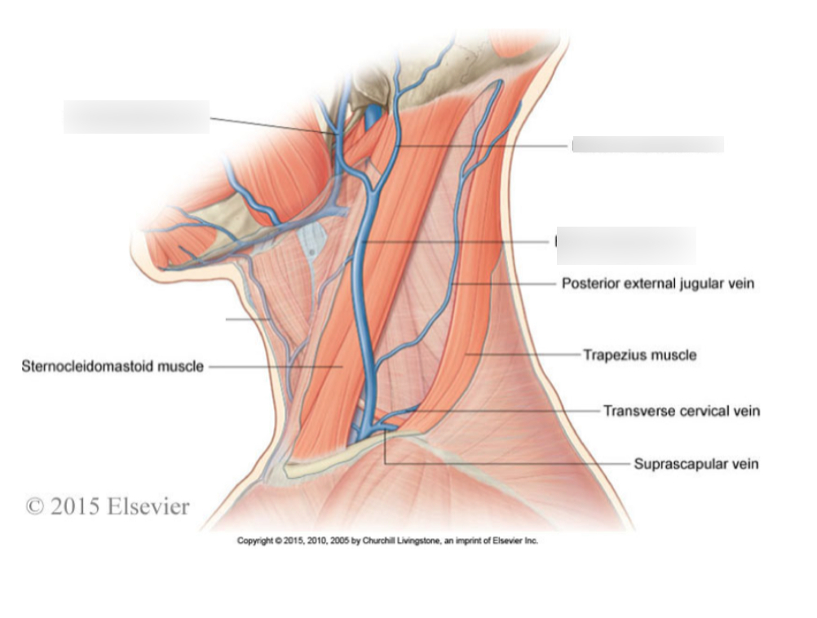
HEAD & NECK
LATERAL REGION
SURFACE LANDMARKS
Mastoid process
Clavicle
Sternocleidomastoid
Trapezius
External jugular vein
Transverse process of the atlas vertebra

Slide 22
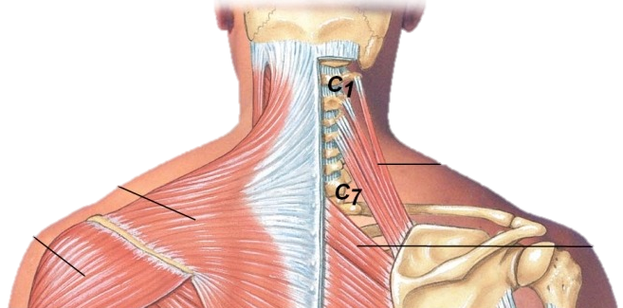
HEAD & NECK
POSTERIOR REGION
SURFACE LANDMARKS
External occipital protuberance
Spine of 7th cervical vertebra (vertebra prominence)
Ligamentum nuchae

Slide 23
CLINICAL SIGNIFICANCE

Slide 24
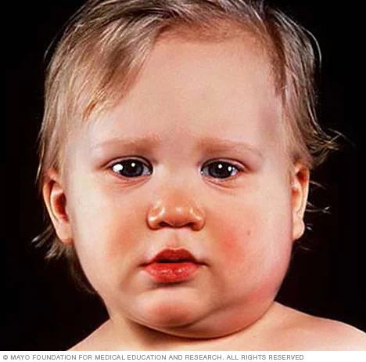
mumps
The parotid gland is enlarged following infection by mumps virus.
This produces a painful swelling in the parotid region.

Slide 25
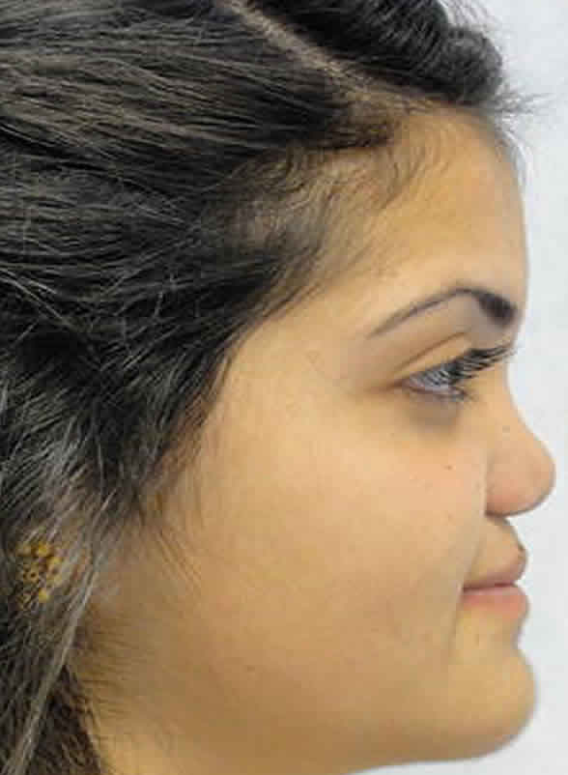
Saddle nose
A nose whose bridge is depressed and widened

Slide 26

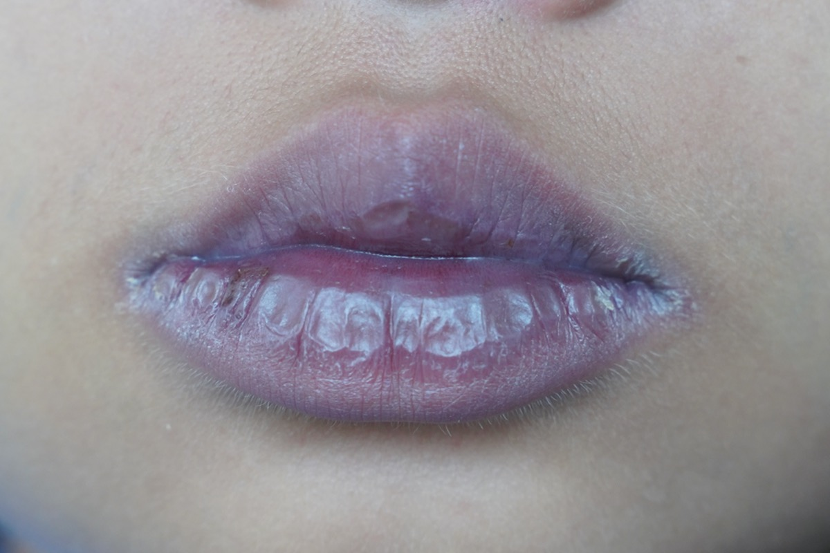

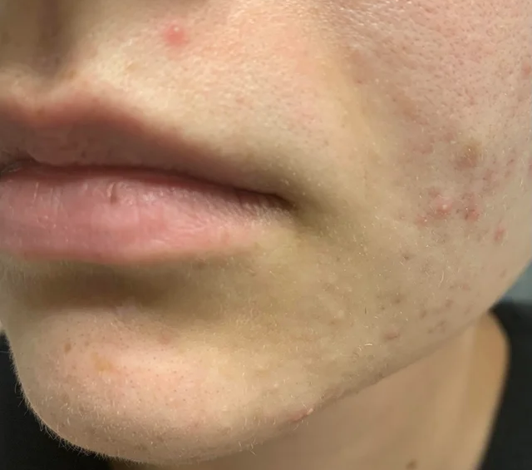
color of lips
The color of the lips and the mucus membrane of the oral cavity are clinically important.
Lips may appear pale in patients with severe anemia or bluish in people suffering from lack of oxygenation of blood (cyanosis).
A lemon yellow tint of lips may indicate jaundice.

Slide 27
END

