Slide 1
INTRODUCTION TO UPPER LIMB & PECTORAL REGION
Dr. ,
Professor, Dept. of Anatomy.

Slide 2
COMPETENCIES : AN 8.1, 8.2, 9.1
SPECIFIC LEARNING OBJECTIVES:
At the end of the class the student must be able to understand the following
Parts of Upper limb
Bone and joints forming it
Origin, insertion, nerve supply and action of Pectoralis Major, Pectoralis Minor, Subclavius and Serratus Anterior.

Slide 3
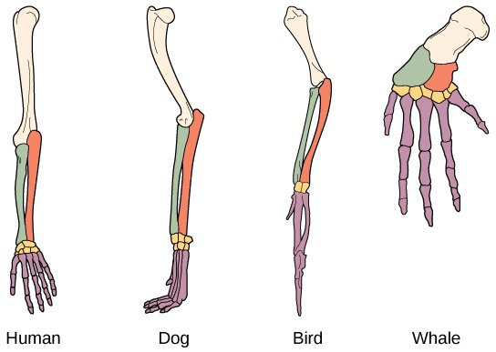
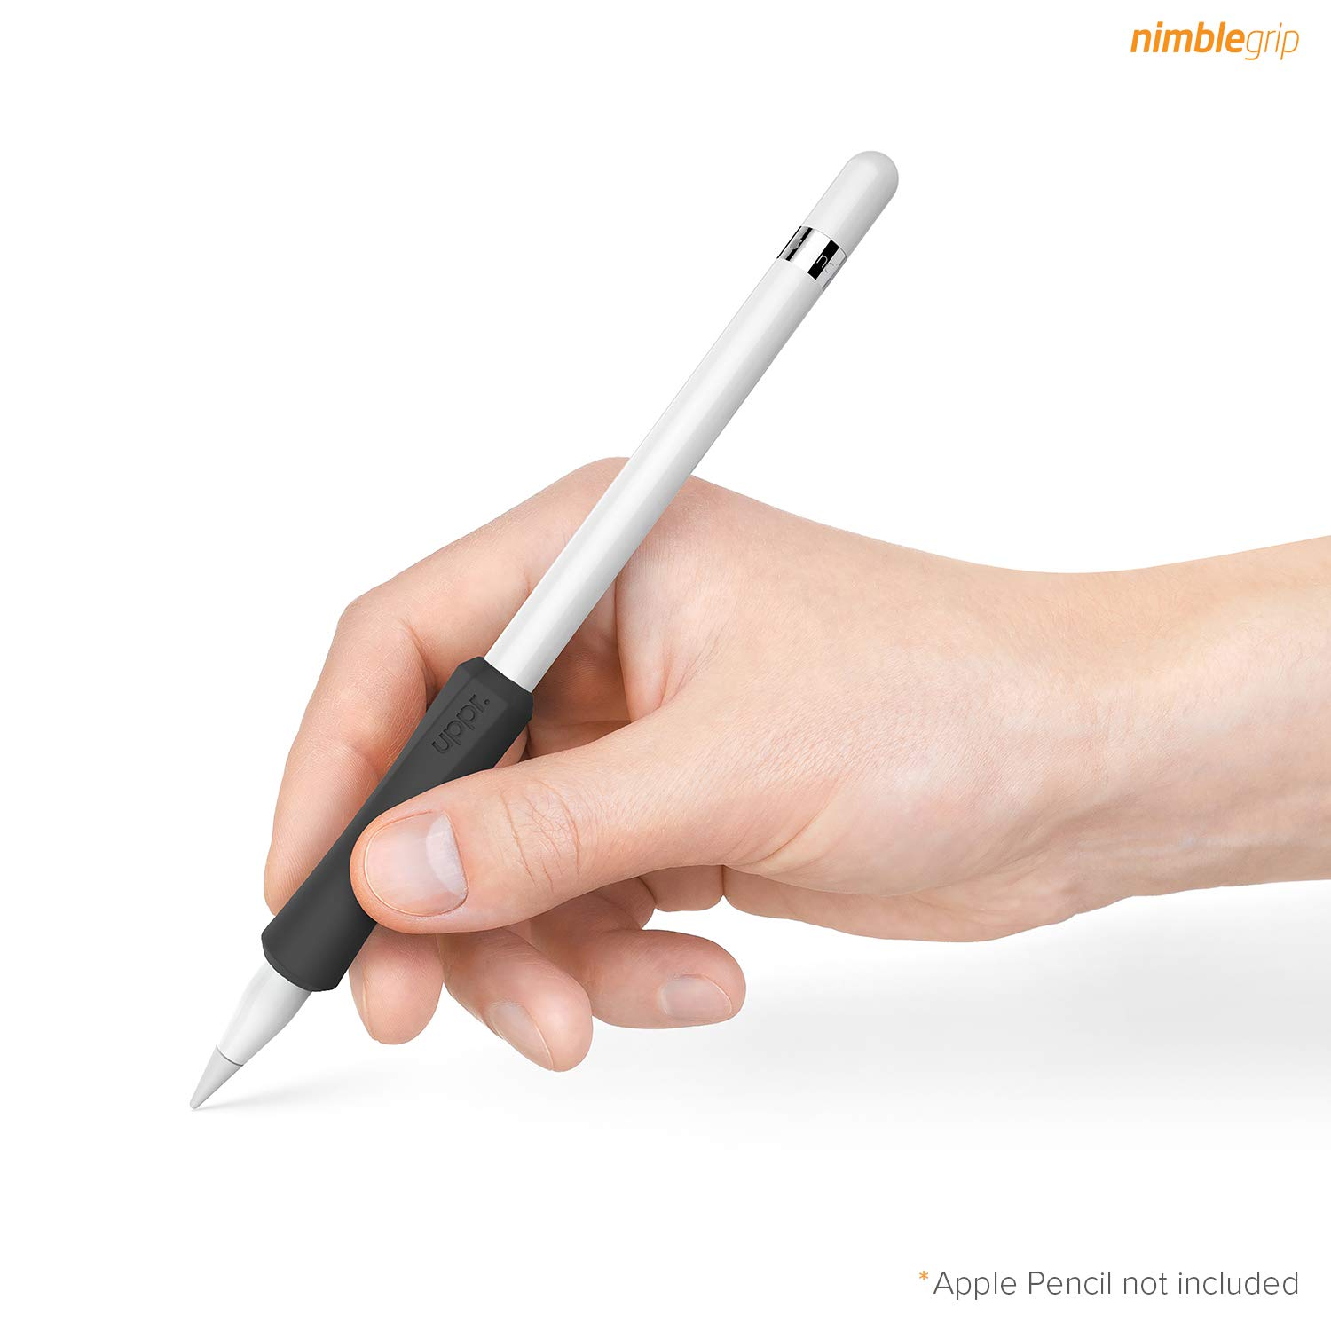
UPPER LIMB---
Introduction
The upper limb is the organ for prehensile activities in Human.
All the terrestrial vertebrates possess four limbs.
In human beings, due to the evolution of erect posture, the function of weight bearing and locomotion is performed only by the lower limbs, while upper limbs are spared for prehensile/manipulative activities.
There are three types of grips: (a) power grip, (b) hook grip, and (c) precision grip.
The precision grip is the special characteristic, only for human beings.
Courtesy Google

Slide 4
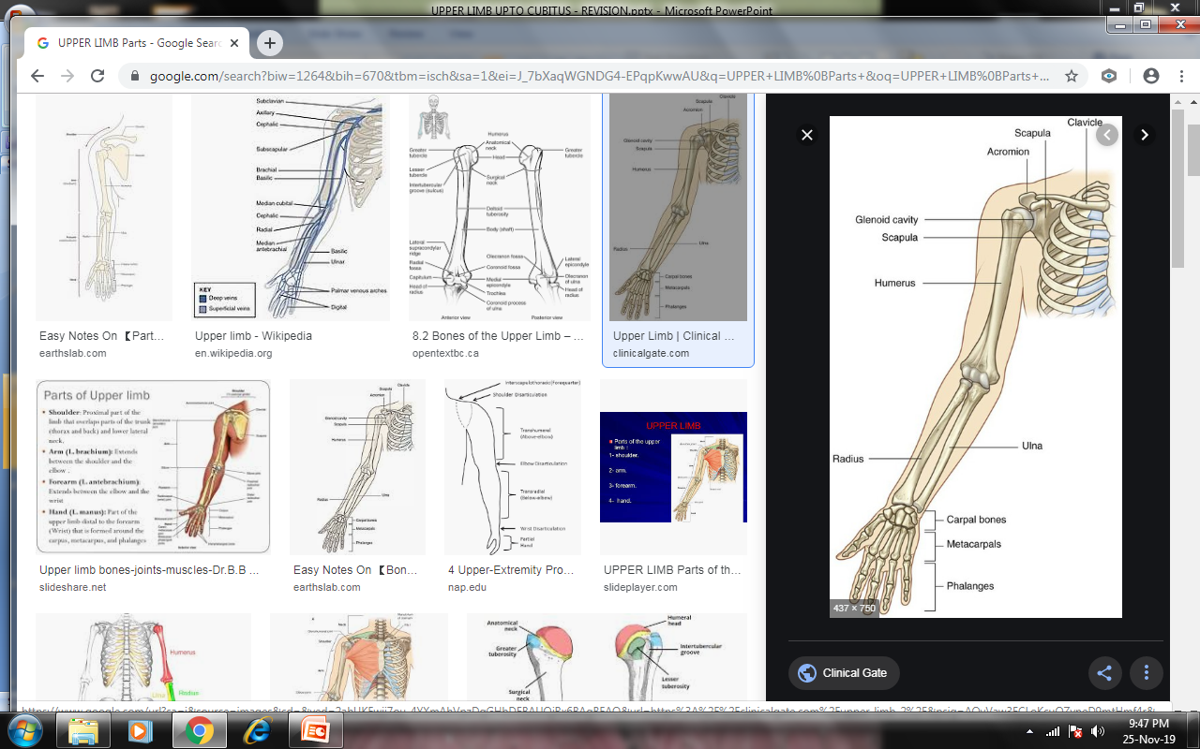
UPPER LIMB
Parts
Upper limb is divided into four major parts
1. Shoulder
2. Arm or brachium
3. Forearm or ante brachium
4. Hand or Manus
Courtesy Google

Slide 5
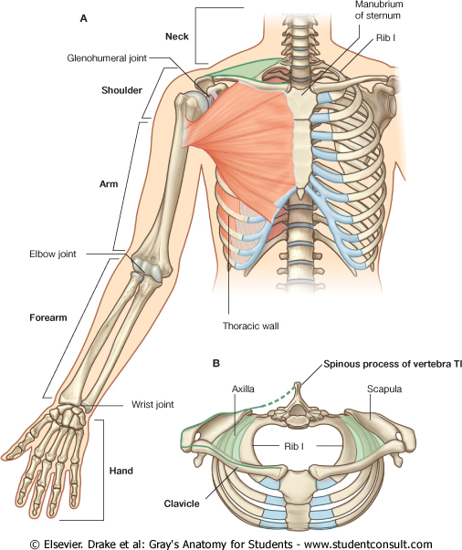
UPPER LIMB
-Joint
Upper limb is connected with the trunk by the pectoral girdle
Shoulder is connected with the arm by the shoulder joint
Arm with forearm by the elbow joint
Forearm with hand by the wrist joint
Carpometacarpal, metacarpophalangeal and interphalangeal joints in hand.
Courtesy Google

Slide 6
UPPER LIMB
Pectoral girdle
The pectoral girdle is composed of two bones, scapula and clavicle.
Scapula is connected to the clavicle by the acromioclavicular joint.
The clavicle is attached to the axial skeleton by the sternoclavicular joint.
It is not a complete girdle as it is attached with the axial skeleton only in the anterior aspect.
Courtesy Google

Slide 7
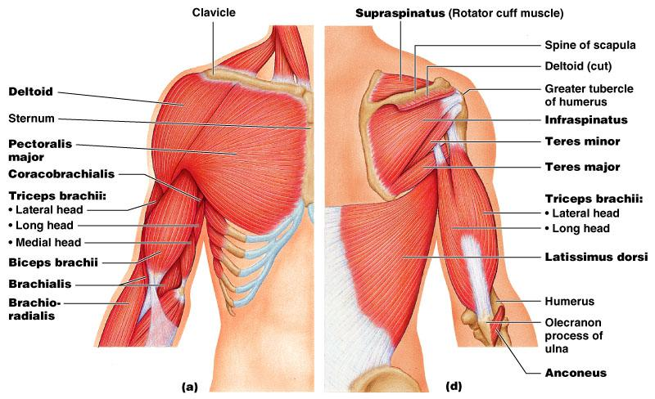
UPPER LIMB
-Shoulder
The shoulder region includes
Pectoral or breast region on the front of the chest.
Scapular region in the back
Axilla or armpit
Bones of shoulder region
Scapula and clavicle
Courtesy Google

Slide 8
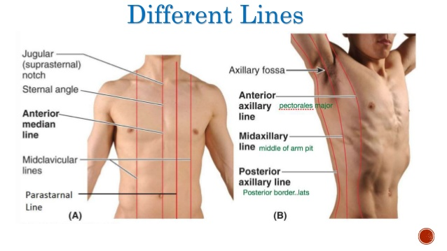
ANTERIOR AXILLARY FOLD – musculocutaneous ridge formed of lateral edge of pectoralis major.
POSTERIOR AXILLARY FOLD – musculocutaneous ridge formed of latissimus dorsi and teres major.
MID AXILLARY LINE - perpendicular line drawn midway between the anterior and posterior axillary folds.
PECTORAL REGION
-Important landmarks
Courtesy Google

Slide 9
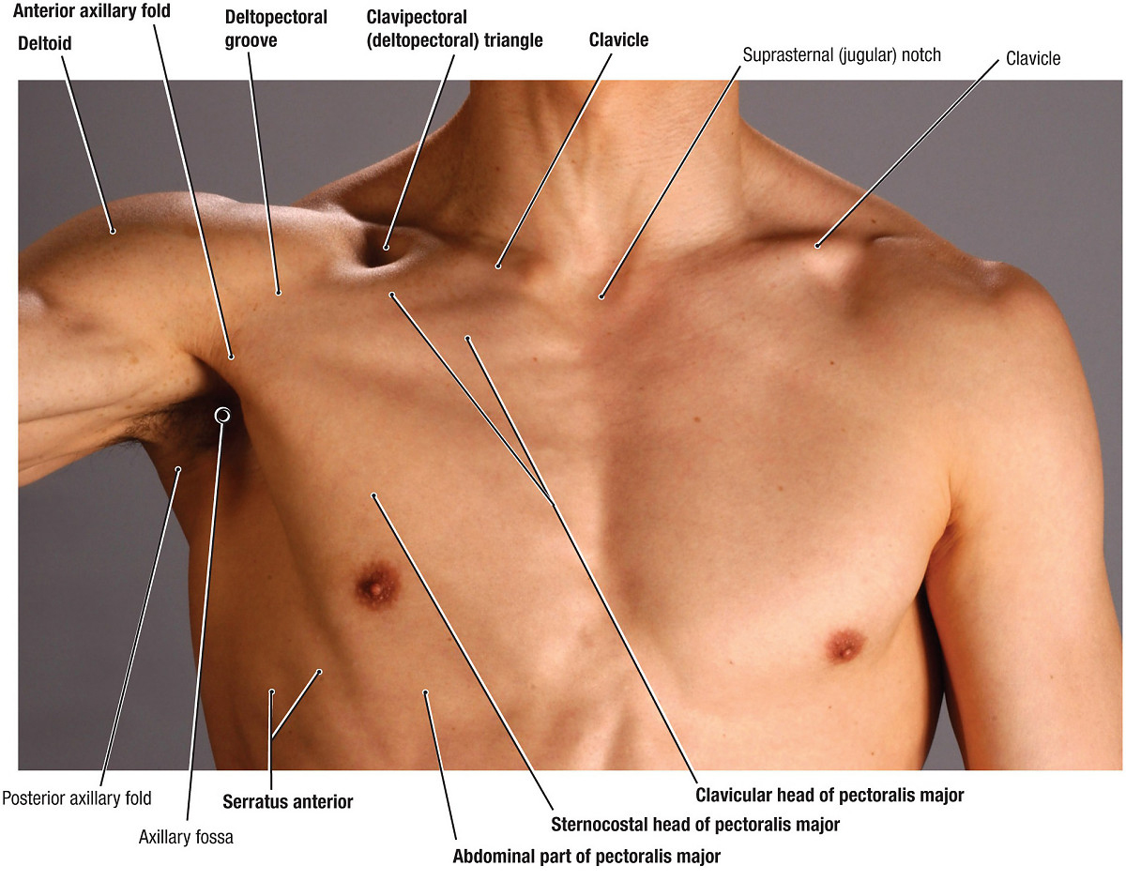
GREATER SUPRACLAVICULAR FOSSA– depression above the middle of the clavicle lateral to sternocleidomastoid.
LESSER SUPRACLAVICULAR FOSSA/ triangle– depression above the clavicle between the two heads of sternocleidomastoid.
DELTOPECTORAL GROOVE- groove between the pectoralis major and deltoid through which the cephalic vein passes.
INFRACLAVICULAR FOSSA/ clavipectoral or deltopectoral triangle-
Clavicle, pectoralis major and deltoid.
PECTORAL REGION
Important landmarks
Courtesy Google

Slide 10
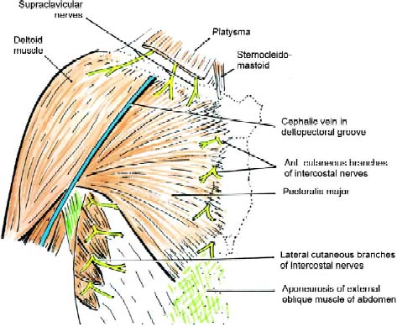
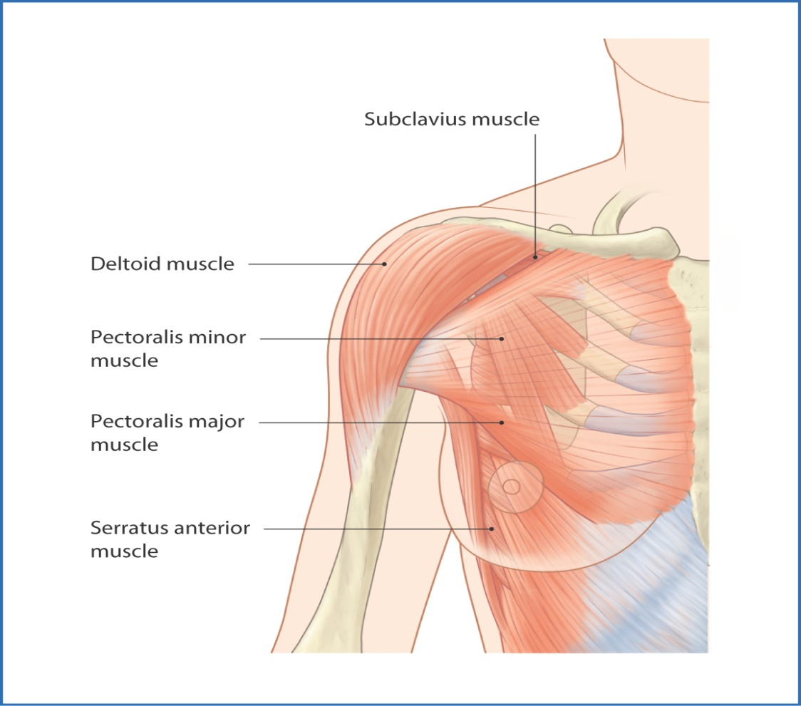
PECTORAL REGION
-contents
Skin & superficial fascia
Upto sternal angle – supraclavicular nerves
Below – anterior and lateral cutaneous branches of 2nd to 6th intercostal
Female - mammary gland
Deep fascia –pectoral fascia
Muscles
Pectoralis major
Pectoralis minor
Subcalvius
Serratus anterior
Between the muscles – clavipectoral fascia.
Courtesy Google

Slide 11
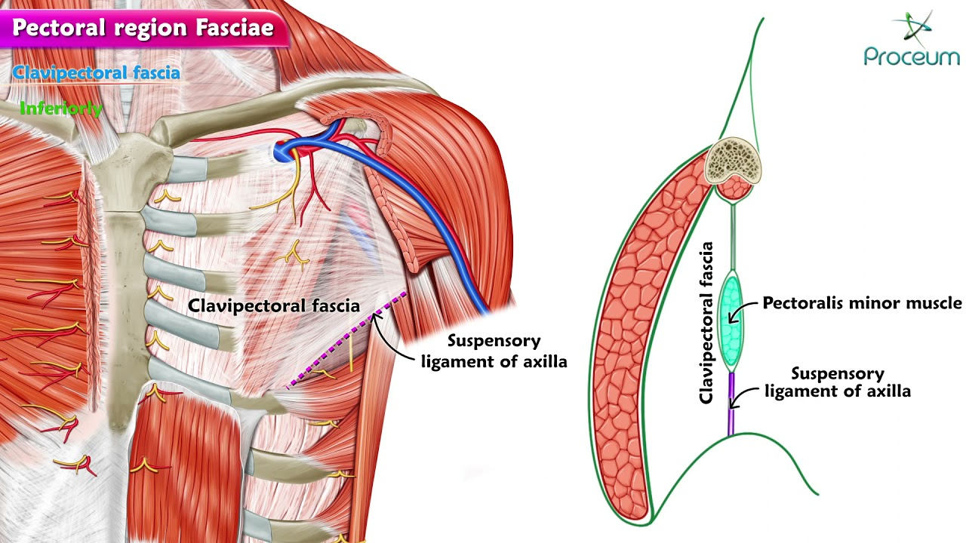
The clavipectoral fascia is a strong fascial sheet deep to the clavicular head of the pectoralis major muscle, filling the space between the clavicle and the pectoralis minor muscle.
CLAVIPECTORAL FASCIA
Courtesy Google

Slide 12
Extent
Vertically-clavicle above axillary fascia below. Its upper part splits into two. Posterior lamina becomes continuous with the investing layer of the deep cervical fascia and gets fused with the axillary sheath. The anterior lamina gets attached to the clavicle.
Its lower part splits to enclose the pectoralis minor muscle
and extends downwards as the suspensory ligament of axilla,
attached to the dome thus maintaining the concavit of the axilla.
CLAVIPECTORAL FASCIA
Courtesy Google

Slide 13
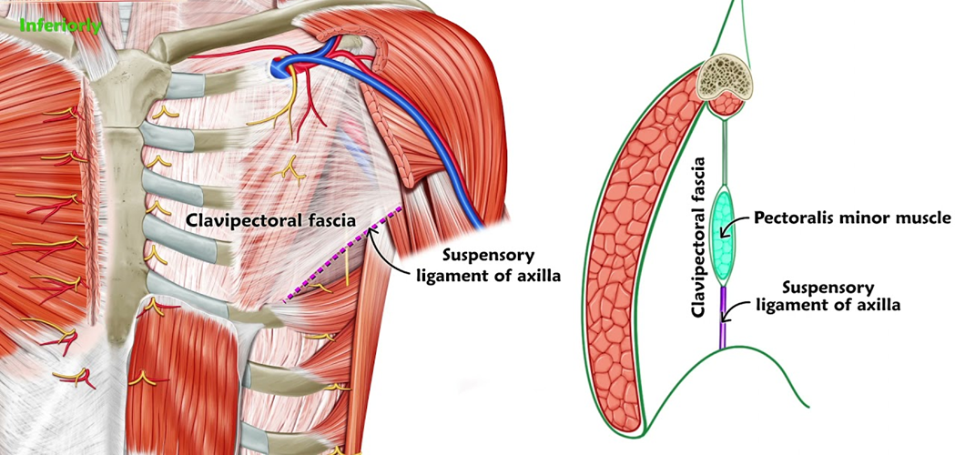
CLAVIPECTORAL FASCIA
Medially- clavipectoral fascia is attached first rib and costoclavicular ligament and blends with the external intercostal membrane of the upper two intercostal spaces.
Laterally blends with the coracoclavicular ligament. The thick upper part of the fascia extending from the first rib near the costochondral junction to the coracoid process as costocoracoid ligament.
Courtesy Google

Slide 14

CLAVIPECTORAL FASCIA
Structures Piercing the Clavipectoral Fascia
Lateral pectoral nerve
Thoracoacromial artery
Lymphatics from the breast to the apical group of the axillary lymph nodes
Cephalic vein
Courtesy Google

Slide 15
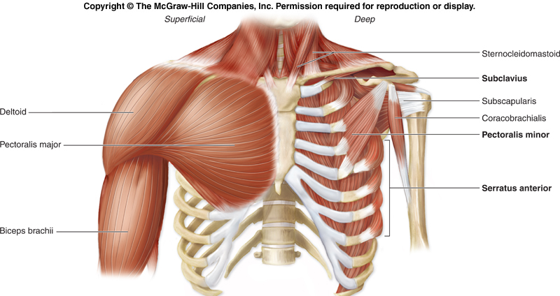
MUSCLES
Pectoralis major
Pectoralis minor
Subcalvius
Serratus anterior
Courtesy Google

Slide 16
PECTORALIS MAJOR
Origin: It has got two head.
Clavicular head arise from front of medial half of clavicle.
Sternocostal head arises from the lateral side of sternum, upper six costal cartilages and external oblique apponeurosis.
Insertion: as U shaped bilaminar (anterior and posterior lamina) tendon into the lateral lip of the bicipital groove.
Nerve supply: Medial (C8,T1)and lateral (C5-C7) pectoral nerve.
ACTION
1. Clavicular head—Flexion of arm.
2. Sternocostal -adduction and medial rotation of arm.
Courtesy Google

Slide 17
PECTORALIS MINOR
DEEP TO PECTORALIS MAJOR.
ORIGIN - IT ARISES FROM RIBS 3-5 NEAR THE COSTAL CARTILAGES.
INSERTION - CORACOID PROCESS OF SCAPULA AS SHORT THICK TENDON
ACTION:
DEPRESS THE SHOULDER POINT
PROTRACTION OF THE SHOULDER GIRDLE.
ACCESSORY MUSCLE OF RESPIRATION.
NERVE SUPPLY: MEDIAL (C8,T1)AND LATERAL (C5-C7) PECTORAL NERVE.
Courtesy Google

Slide 18
SUBCLAVIUS
ORIGIN – COSTOCONDRAL JUNCTION OF 1ST RIB
INSERTION - LOWER SURFACE OF THE MIDDLE THIRD OF CLAVICLE (SUBCLAVIAN GROOVE).
ACTION: STABILIZE THE CLAVICLE DURING MOVEMENTS OF THE SHOULDER JOINT.
NERVE SUPPLY: NERVE TO SUBCLAVIUS.
Courtesy Google

Slide 19
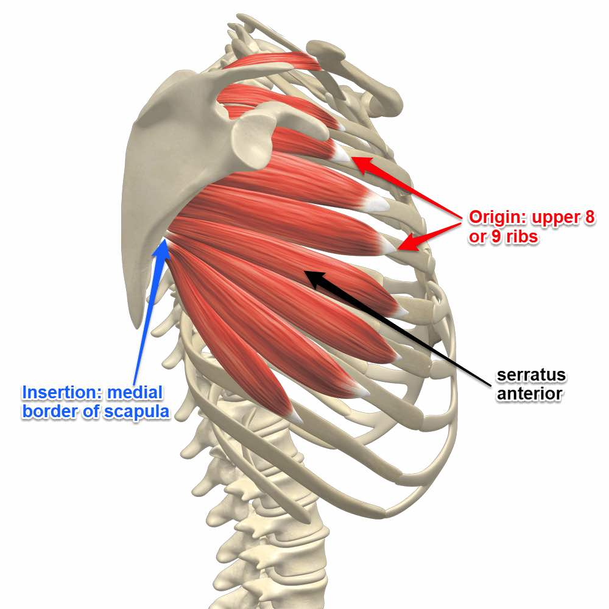
SERRATUS ANTERIOR
Origin – as 8 digits -originates at the side of the chest from the upper 8 or 9 ribs.
Insertion - entire length of the costal aspect of the medial border of the scapula.
Nerve supply: (Nerve to serratus anterior C5, C6, C7) long thoracic nerve.
Action: Rotates the scapula laterally and upwards.
Powerful protractor of scapula in pushing and punching(Boxer’s muscle).
Courtesy Google

Slide 20
CLINICAL SIGNIFICANCE

Slide 21
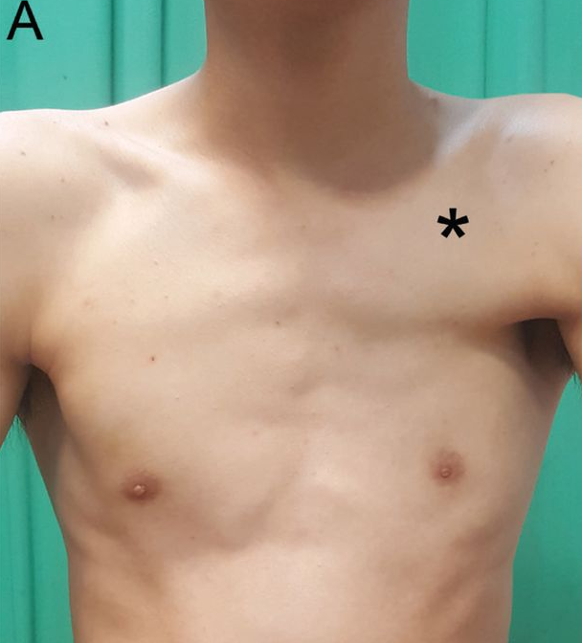
CONGENITAL ANOMALY PECTORALIS MAJOR
Occasionally, the sternocostal part of pectoralis major is absent at birth.
Leads to weakness in adduction and medial rotation of arm.

Slide 22
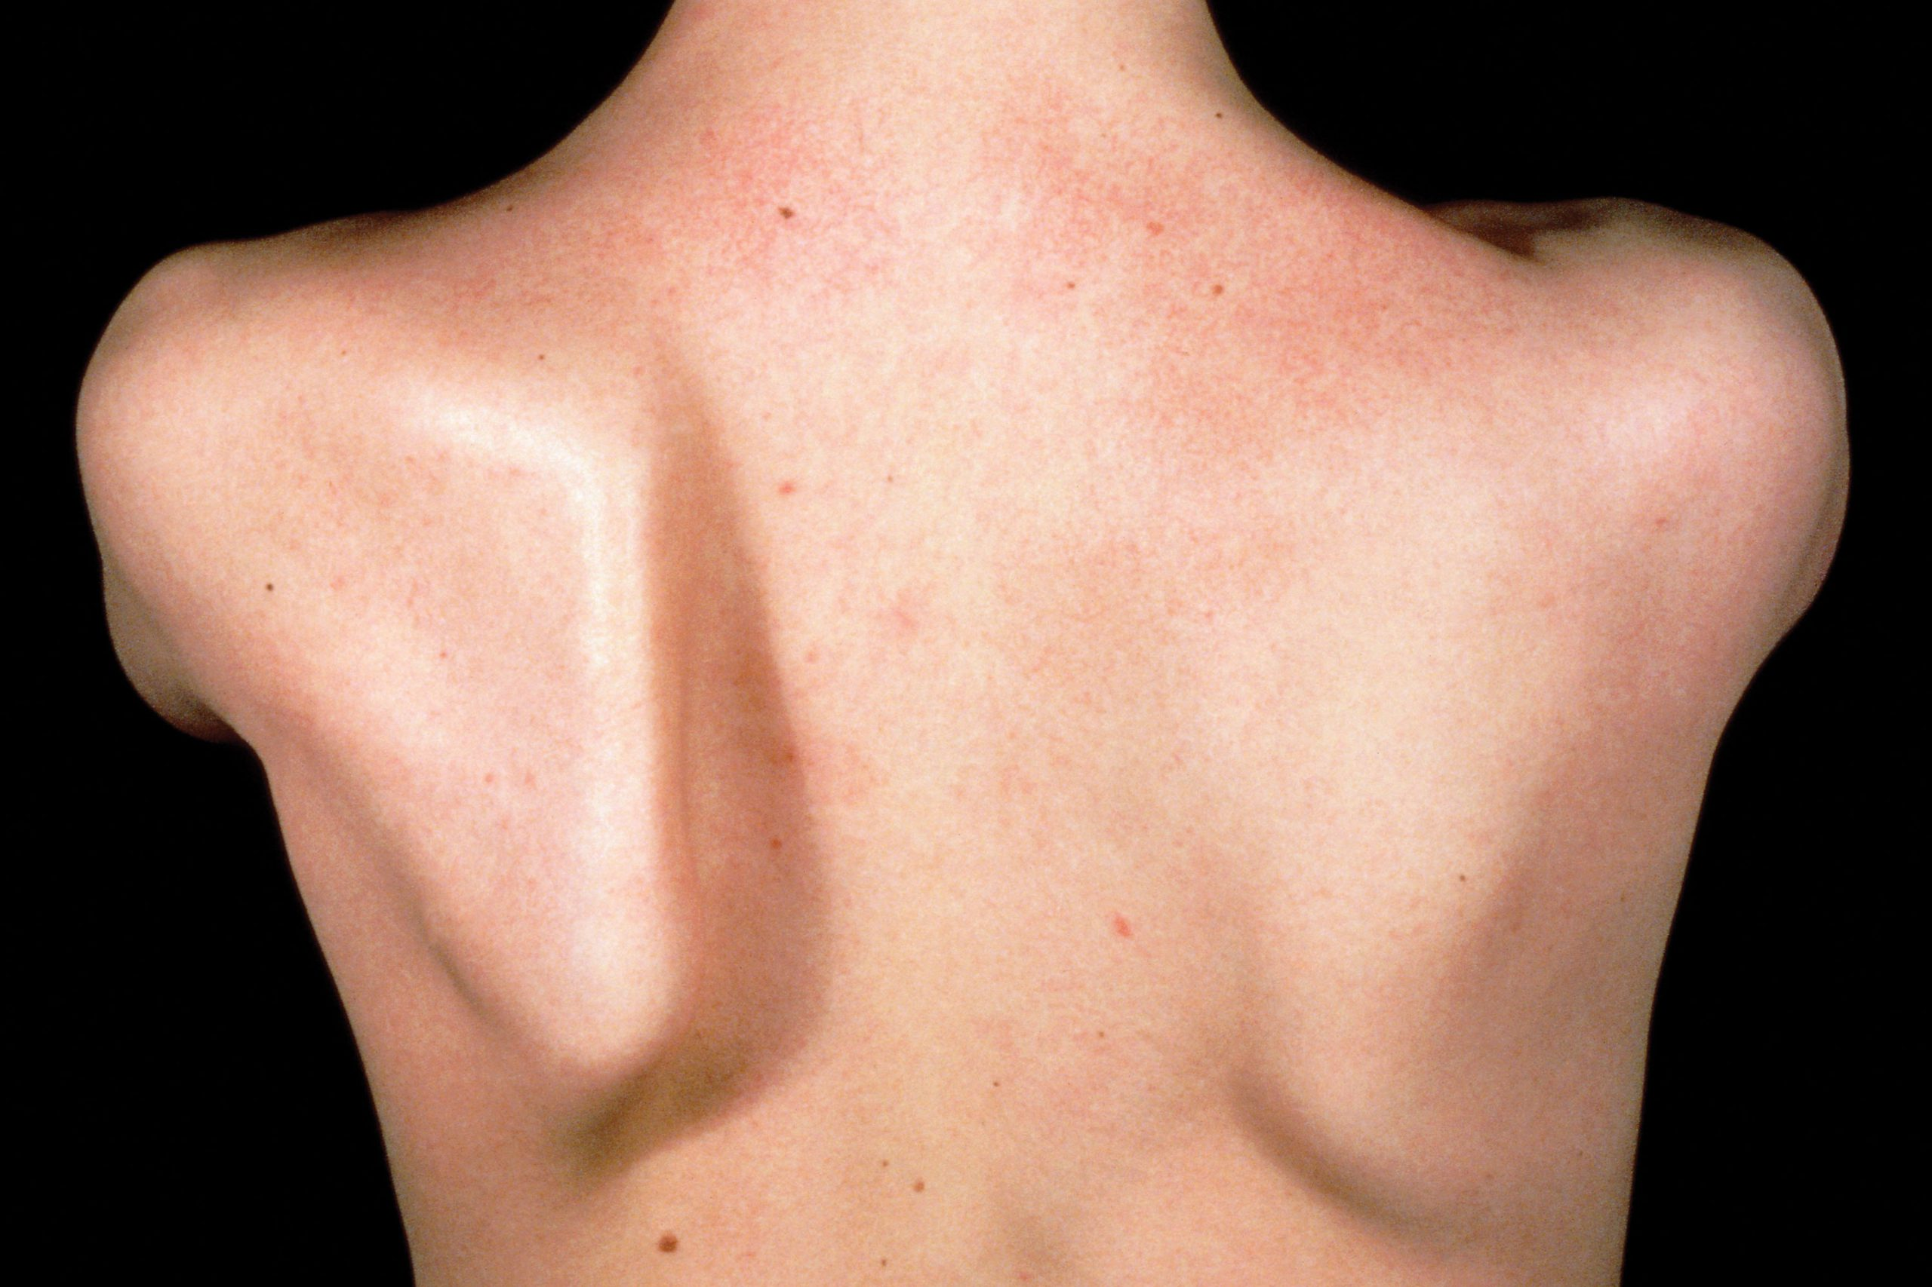
PARALYSIS OF SERRATUS ANTERIOR WINGING OF SCAPULA
Following an injury to long thoracic nerve by stab injury or removal of breast tumor.
Effects :
Protraction of the scapula is weakened.
Inferior angle and medial border of the scapula become unduly prominent and look like a wing, when the patient pushes his hands against the wall, the clinical condition is “winging of scapula”.

Slide 23
END

