Slide 1
BUY PPT
Ref. Website – anatomyandme.com

Slide 2
SCALP
Dr. ,
PROFESSOR, DEPT. OF ANATOMY.

Slide 3
COMPETENCIES :AN 27.1.2, AN 27.1.3, AN 27.1.4, AN 27.2.1, AN 27.2.2.
SPECIFIC LEARNING OBJECTIVES:
At the end of the class the student must be able to understand the following
Layers of skull
Clinical significance regarding each layer of scalp
Demonstrate Scalp

Slide 4
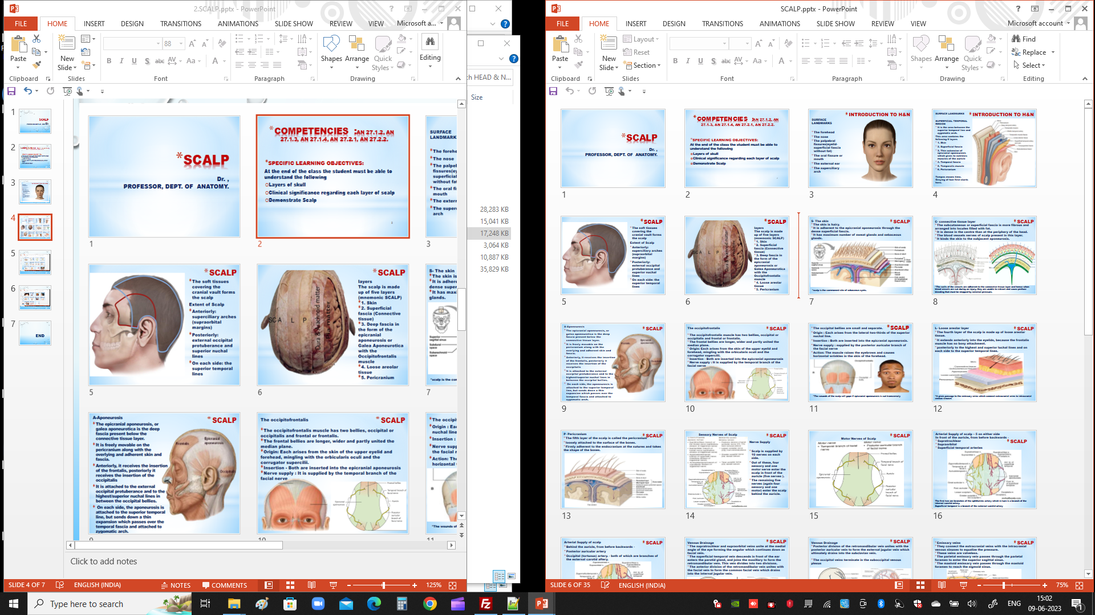

Slide 5
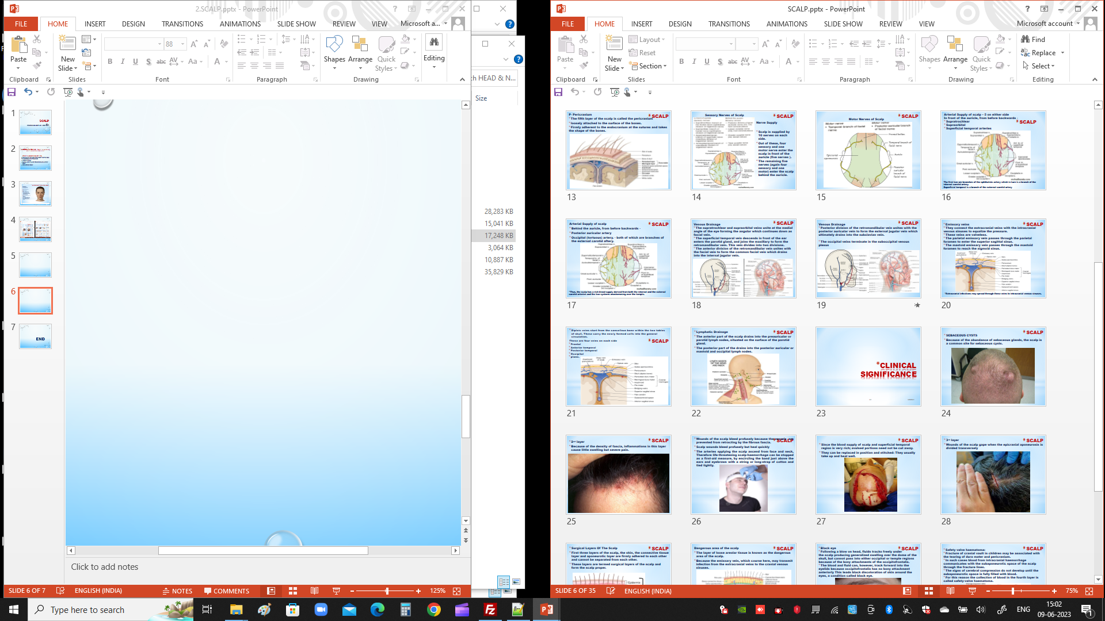

Slide 6
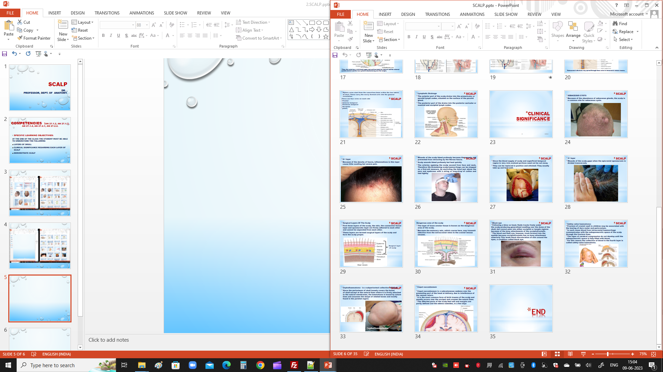

Slide 7
BUY PPT
Ref. Website – anatomyandme.com

Slide 8
END

